Slide 1
Machine Learning
COURSE DIT 821
Regularized Linear Regression and Bias v.s. Variance
and
Polynomial Regression
Lab 3
Notes:
Formulas: https://www.overleaf.com/7364645532sncrmcjkdxdk

Slide 2
Lab 3 topics
Regularized Linear Regression
Bias-variance
Polynomial regression

Slide 3
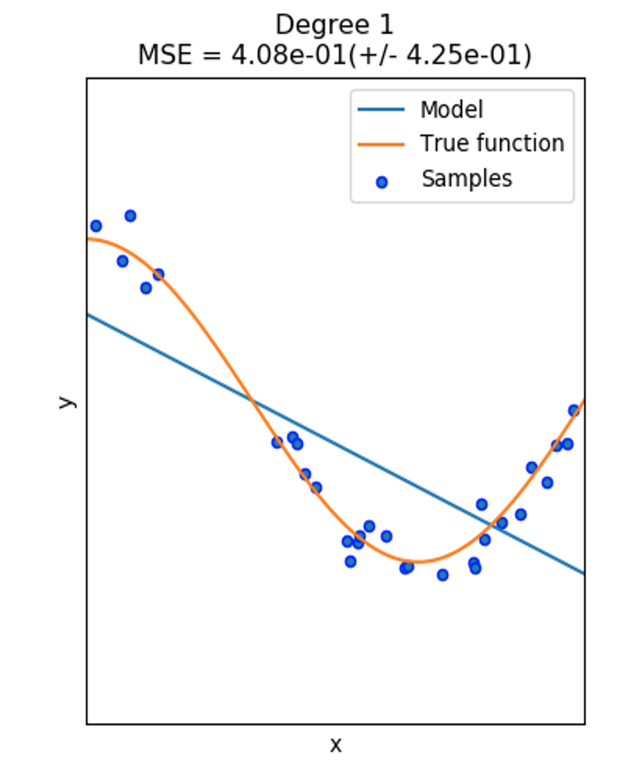
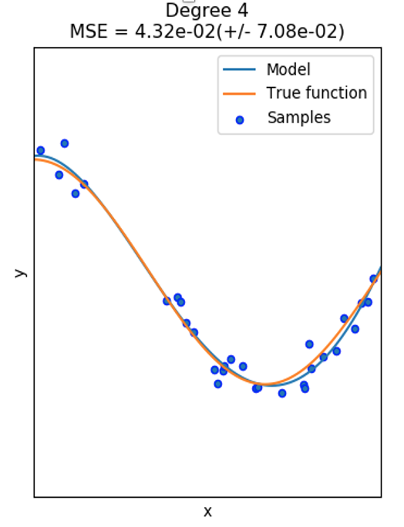


Linear regression
Linear Regression
Polynomial
$$h_{w}\left(x\right)=w_{0}+w_{1}x$$
$$h_{w}(x)=w_{0}+w_{1}x_{1}+…+w_{n}x_{n}$$
$x_{1}=x, x_{2}=x^{2},…,x_{n}=x^{n}$
$$h_{w}\left(x\right)=w_{0}+w_{1}x+…+w_{n}x^{n}$$

Slide 4
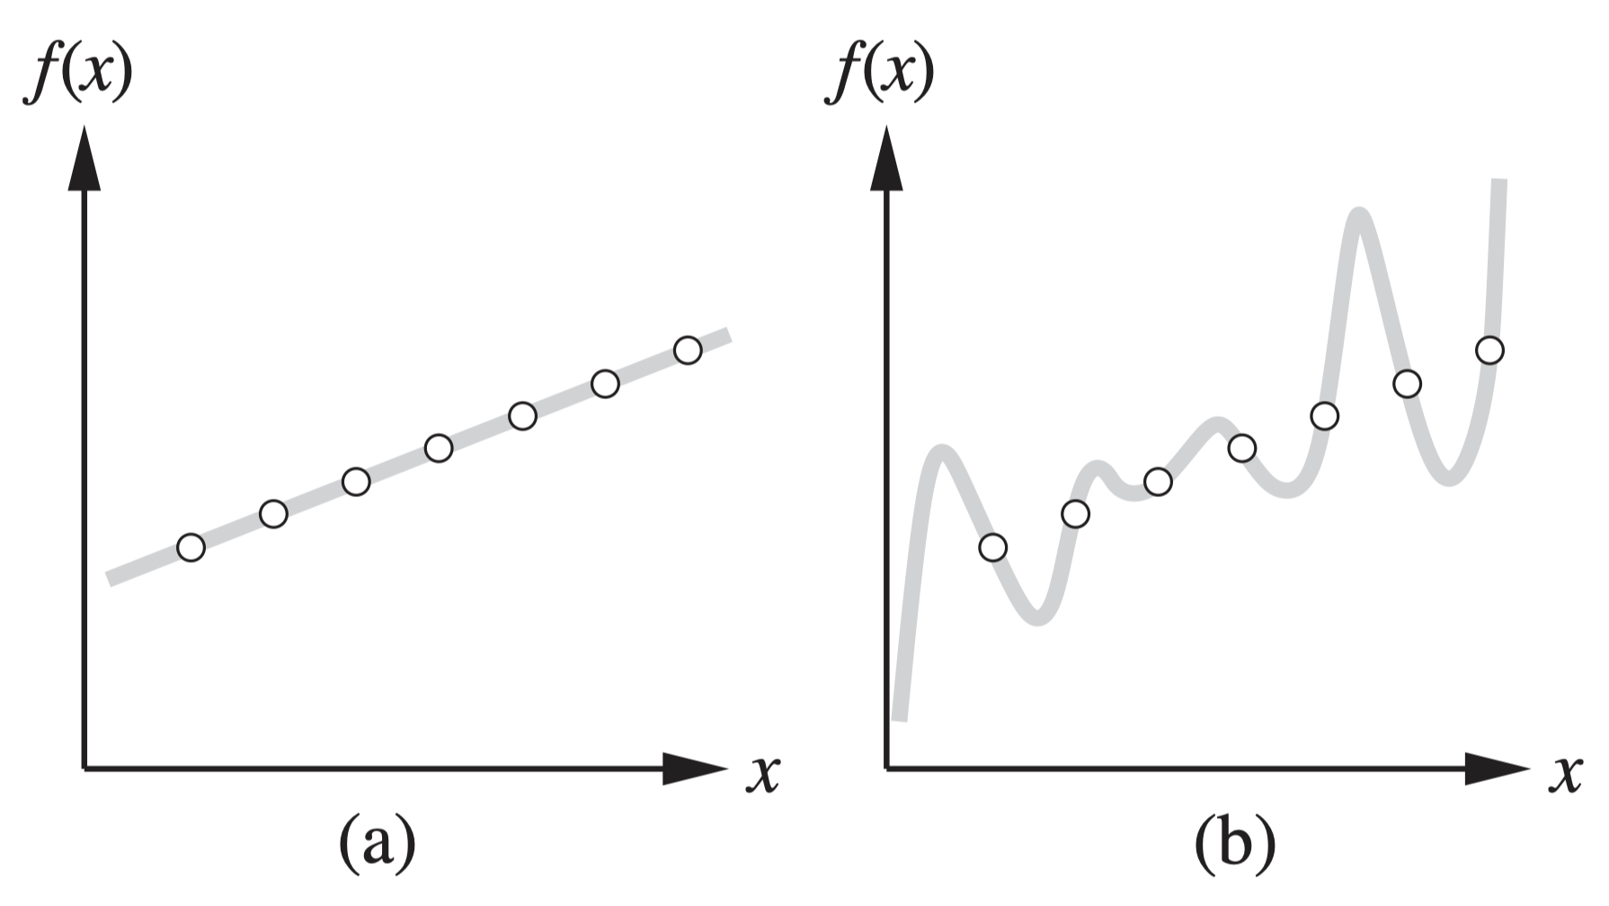
Polynomial Regression
How to choose from among multiple consistent hypotheses?
7-degree polynomial
1-degree polynomial
Example from: Russel, Norvig - Artificial Intelligence - A Modern Approach (3rd Edition)
Notes:
(a) Example (x, f(x)) pairs and a consistent, linear hypothesis. (b) A consistent, degree-7 polynomial hypothesis for the same data set.
English philosopher William of Ockham, who used it to argue sharply against all sorts of complications.
Deﬁning simplicity is not easy, but it seems clear that a degree-1 polynomial is simpler than a degree-7 polynomial, and thus (a) should be preferred to (b).

Slide 5
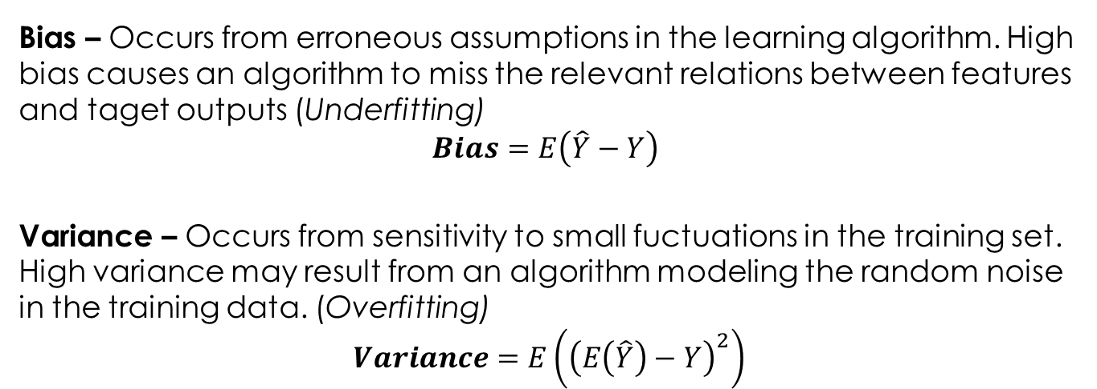
Bias and Variance
Bias – Occurs from erroneous assumptions in the learning algorithm. High bias causes an algorithm to miss the relevant relations between features and taget outputs (Underfitting)
$$Bias=E\left(\hat{Y}−Y\right)$$
Variance – Occurs from sensitivity to small fuctuations in the training set. High variance may result from an algorithm modeling the random noise in the training data. (Overfitting)
$$Variance=E\left({\left(E\left(\hat{Y}\right)−Y\right)}^{2}\right)$$
Example from: Russel, Norvig - Artificial Intelligence - A Modern Approach (3rd Edition)
Notes:
(a) Example (x, f(x)) pairs and a consistent, linear hypothesis. (b) A consistent, degree-7 polynomial hypothesis for the same data set.
English philosopher William of Ockham, who used it to argue sharply against all sorts of complications.
Deﬁning simplicity is not easy, but it seems clear that a degree-1 polynomial is simpler than a degree-7 polynomial, and thus (a) should be preferred to (b).

Slide 6
Underfitting-Overfitting
If the model is too simple, the solution is biased and does not fit the data
If the model is too complex then it is very sensitive to small changes in the data
High-Bias / Low-Variance
(underfitting)
Low-Bias / High-Variance
(overfitting)

Slide 7
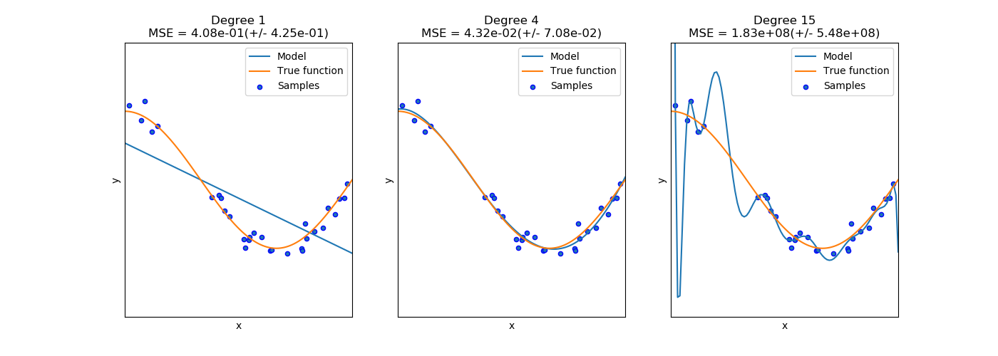
The problem of overfitting and underfitting
X
X
X
underfit “high bias”
generalises well “just right”
overfit “high variance”
Tradeoff between complex hypotheses that ﬁt the training data well and simpler hypotheses that may generalize better
https://scikit-learn.org/stable/auto_examples/model_selection/plot_underfitting_overfitting.html The problem of overfitting: https://www.coursera.org/learn/machine-learning/lecture/ACpTQ/the-problem-of-overfitting
Notes:
By increasing the degree of the polynomial the curve can fit more the training data but..
If we have too many features to learn we go overfitting

Slide 8
Reduce overfitting amd underfitting.
Underfitting
Increase model complexity
Increase number of features
Remove noise from data
Increase training time
Overfitting
Increase training data
Reuce model complexity
Early Stopping
Regularization
Dropouts (Neural Networks)
Example from: Russel, Norvig - Artificial Intelligence - A Modern Approach (3rd Edition)
Notes:
(a) Example (x, f(x)) pairs and a consistent, linear hypothesis. (b) A consistent, degree-7 polynomial hypothesis for the same data set.
English philosopher William of Ockham, who used it to argue sharply against all sorts of complications.
Deﬁning simplicity is not easy, but it seems clear that a degree-1 polynomial is simpler than a degree-7 polynomial, and thus (a) should be preferred to (b).

Slide 9
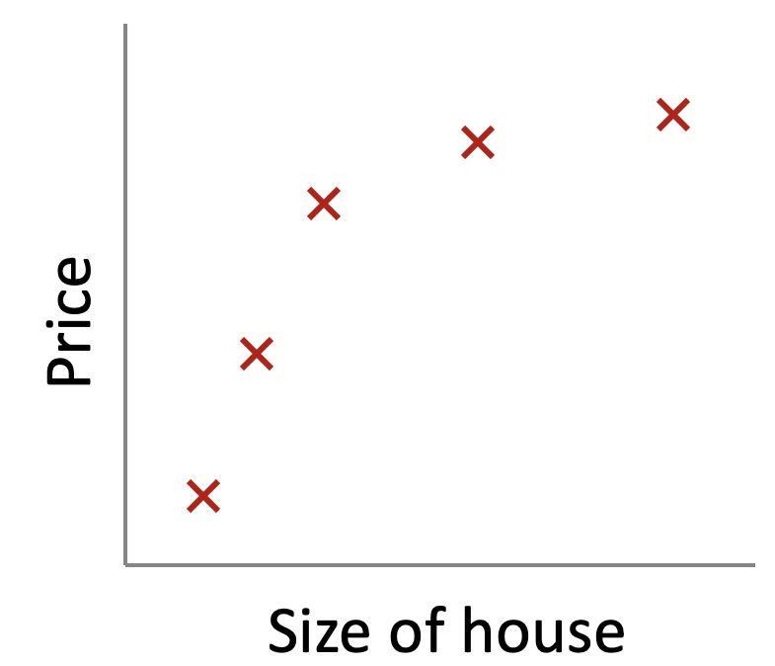


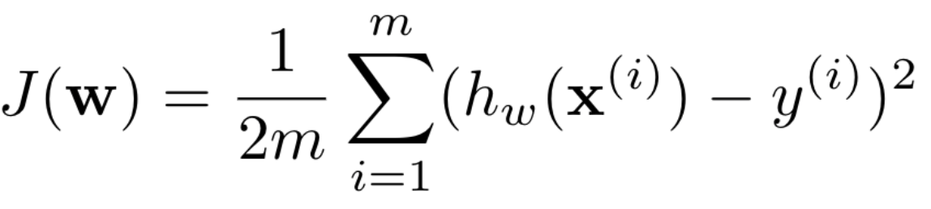
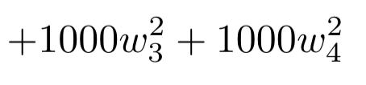

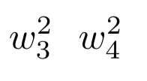
Regularization
Small values for the parameters =>
Simpler hypothesis => Less prone to overfitting
Intuition Example
Will shrink and
https://www.coursera.org/learn/machine-learning
Hundred-Page Machine Learning Book
Notes:
On the other hand, if we set to LAMBDA to a high value, the learning algorithm will try to set most w (j) to a very small value or zero to minimize the objective, the model will become very simple which can lead to underﬁtting. Your role as the data analyst is to ﬁnd such a value of the hyperparameter LAMBDA that doesn’t increase the bias too much but reduces the variance to a level reasonable for the problem at hand.

Slide 10

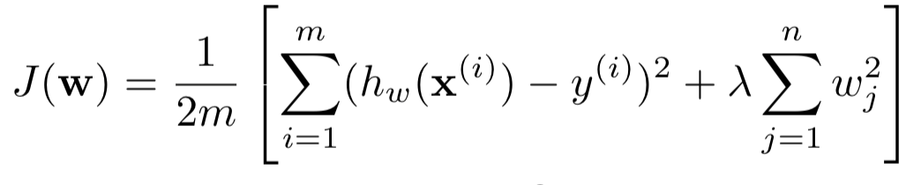

Regularization
Intuition
We modify the objective function by adding a penalizing term whose value is higher when the model is more complex
Cost function:
Regularization Term
Regularized cost function:
Regularization Parameter
High-value, model can become very simple and lead to underfitting
Tradeoff, ﬁnd such a value of that doesn’t increase the bias too much but reduces the variance to a level reasonable for the problem at hand.
Low-value, less regularized, can overfit
https://www.coursera.org/learn/machine-learning
Hundred-Page Machine Learning Book
Notes:
Generally we don’t know which parameter to pick an penalize. So we shrink all the parameters.
On the other hand, if we set to LAMBDA to a high value, the learning algorithm will try to set most w (j) to a very small value or zero to minimize the objective, the model will become very simple which can lead to underﬁtting. Your role as the data analyst is to ﬁnd such a value of the hyperparameter LAMBDA that doesn’t increase the bias too much but reduces the variance to a level reasonable for the problem at hand.
Start with lambda equal to one and see how it performs

Slide 11
Note
Minimizing Training Loss is Not our Real Goal
What we actually want to minimize is expected loss on new examples
Notes:
http://www.cs.cornell.edu/courses/cs6787/2017fa/Lecture2.pdf

Slide 12
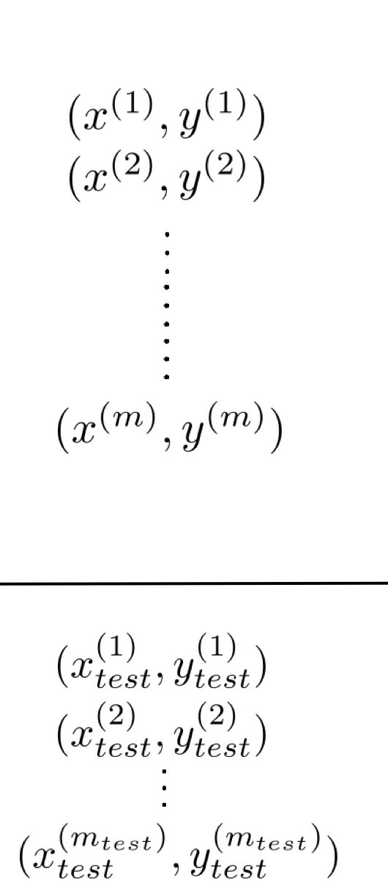
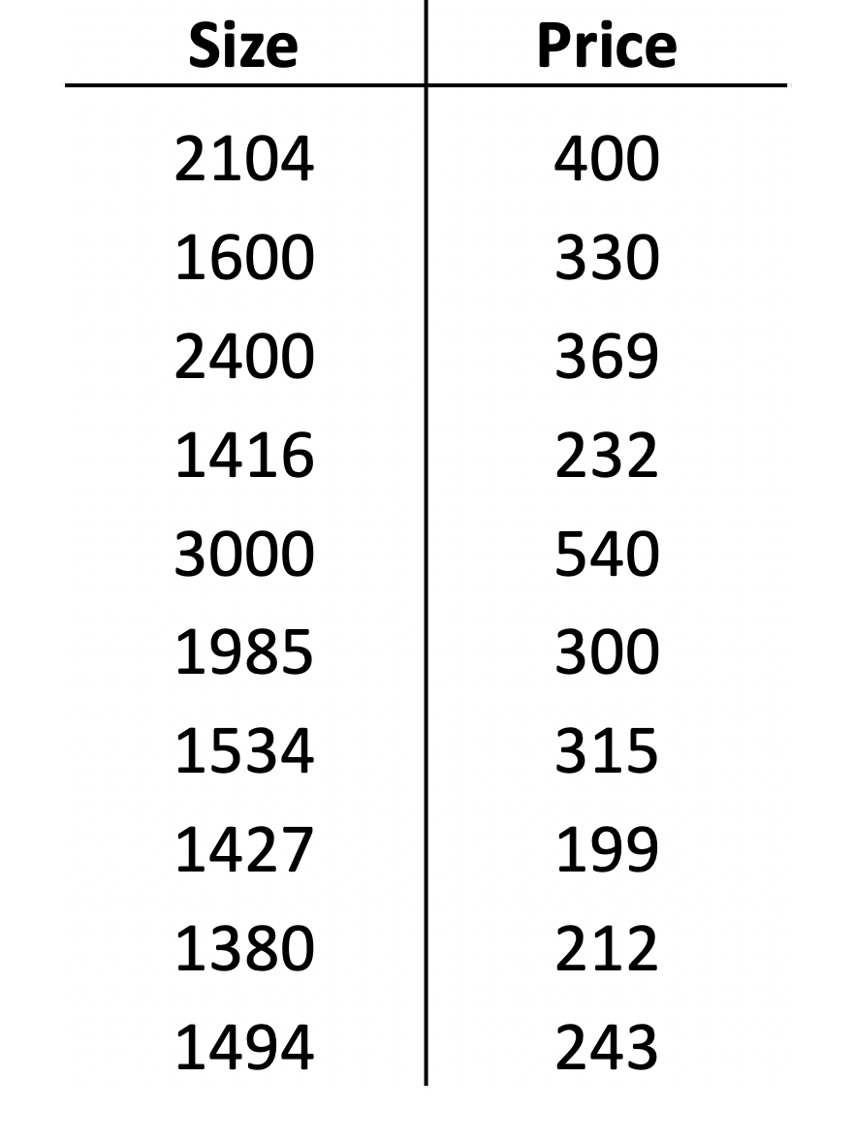
Evaluating Hypothesis
How to evaluate overfitting Bias-Variance
70%
Training set
30%
Test set

Slide 13
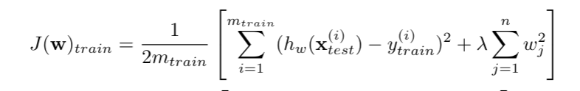
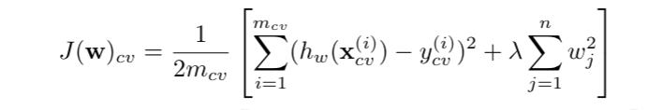
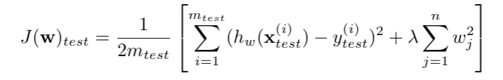
How to test if h is over(under)fitted?
Data set
Training set
60%
Validation set
20%
Test
Set
20%

Slide 14
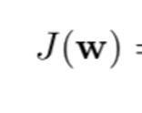
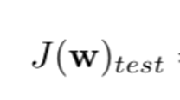
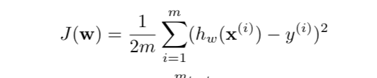
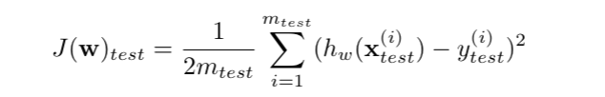
Bias vs. Variance – we change degree of polynomial
Best degree
Degree of polynomial

Slide 15
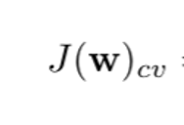
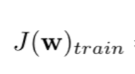


Bias/variance as a fynction of the regularization parametear
Variance
bias
$$λ$$
0
Best
$$λ$$
(1000)

Slide 16
Bias/variance as a function of data set
High bias
Best
M (training set size)

Slide 17
Addressing Overfitting
Concrete Options
Try a Simpler model
Linear instead of polynomial
Reduce number of Features (reduce the dimensionality of the dataset)
Manually look across the features and select the most important ones
Automatically reduce feature with model selection algorithm
Add mode training data, if possible
Regularize the model
Keep all the features, but reduce magnitude/values of the parameters
- Most widely used approach to prevent overfitting
https://www.coursera.org/learn/machine-learning
Hundred-Page Machine Learning Book
Notes:
Plotting the hypothesis, could be one way to try to decide what degree polynomial to use. But that doesn't always work. And, in fact more often we may have learning problems that where we just have a lot of features. And there is not just a matter of selecting what degree polynomial. And, in fact, when we have so many features, it also becomes much harder to plot the data and it becomes much harder to visualize it, to decide what features to keep or not.
model selection algorithms. Which are algorithms for automatically deciding which features to keep and, which features to throw out.

